Slide 1
Sequence to Sequence
Sungjoon Choi
Colah’s blog: http://colah.github.io/posts/2015-08-Understanding-LSTMs/

Slide 2
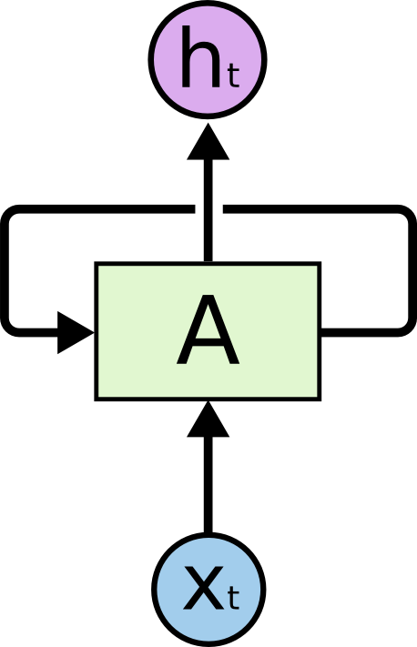
RNN
This recurrent connection
makes the difference

Slide 3

Unrolling through Time
Key observation is that if we unroll the RNN through time, RNN becomes feedforward neural network with large width.

Slide 4

LSTM
Output (Hidden State)
Forget Gate
(Cell) state
Next (Cell) State
Input Gate
Output Gate
Hidden State
Next Hidden State
Input

Slide 5
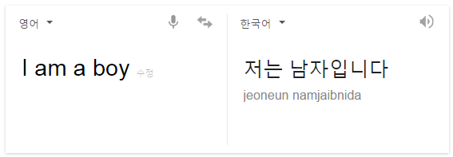
Seq2seq
Sequence to sequence learning with RNN
Given a sequence, our object is to find a corresponding sequence
Examples: Language transition

Slide 6

Seq2seq
Sequences have different lengths
How can we make sequences with different lengths?
<EOS> token is used!

Slide 7
Seq2seq
Suppose we want to translate ‘안녕’
X
H
I
<EOS>
안
녕
<EOS>
X
H
I
Identical RNN!

Slide 8
CHAR RNN
NeuralNet
next character[vocab_size]
next character[vocab_size]
rnn_output[rnn_size]
rnn_output[rnn_size]
RNN@t-1
RNN@t
RNN@t
Embedding
rnn_input[rnn_size]
rnn_input[rnn_size]
character[vocab_size]
character[vocab_size]

Slide 9
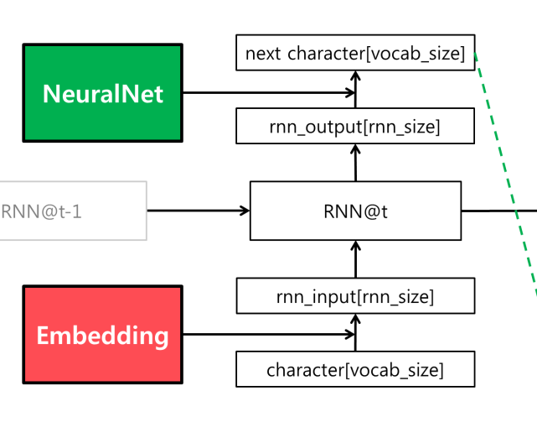
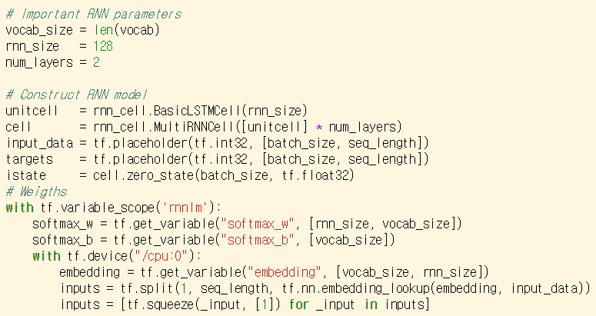
Implementation - training
Output
LSTM
LSTM
Input

Slide 10
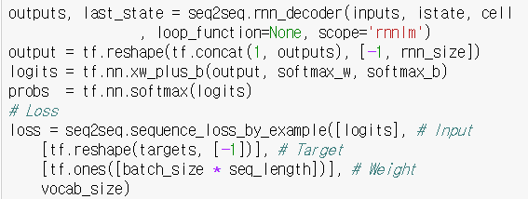
Implementation - training

Slide 11
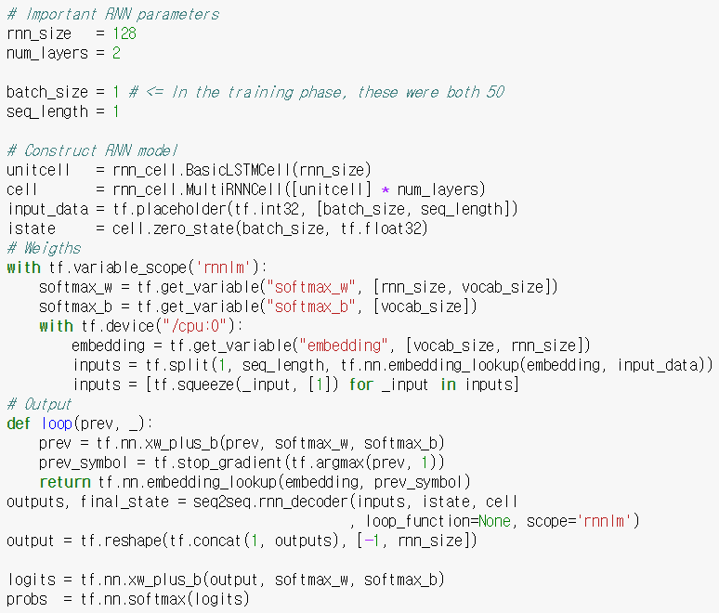
Implementation - sampling

Slide 12
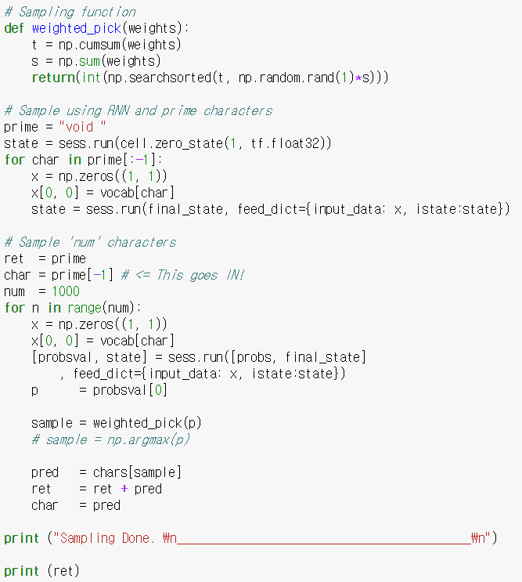

Implementation - sampling
Warm up RNN with prime characters
Sample 1,000 characters

Slide 13
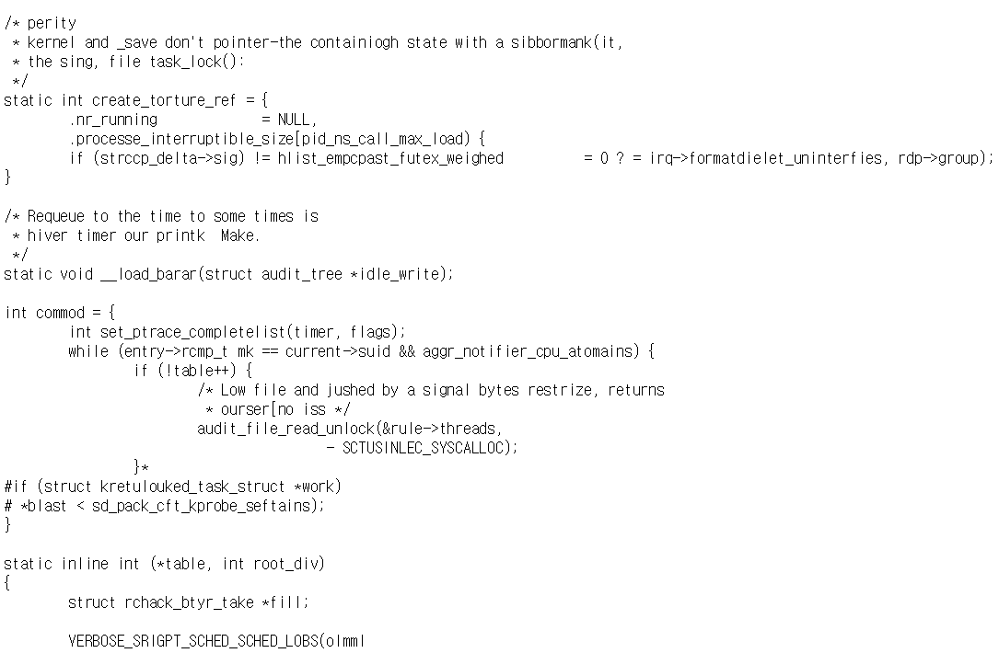
Results

Slide 14
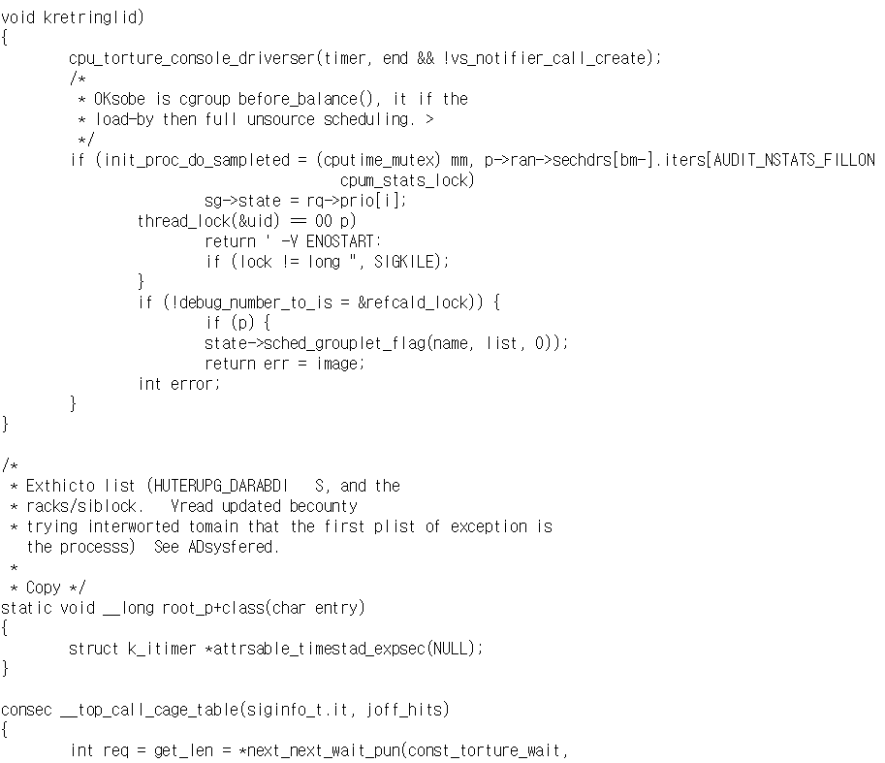
Results

Slide 15
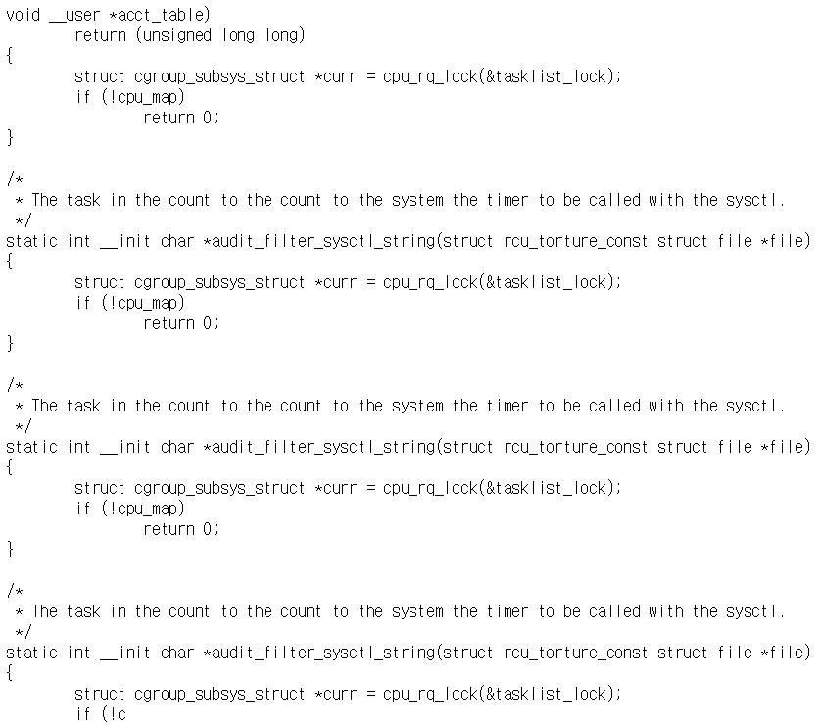
Results

